Slide 1

Parking Space Identifier and Creator

Slide 2
PROBLEM
India is the fourth largest country in its Automobile Production and it is second largest country in its population
With such large number of vehicles driven by large number of people, Parking has become one of key challenge that is being faced by many people in urban areas and metro-politan.
Parking problems is not a single problem alone but in turn it causes many sub problems like
Loss of time , energy and fuel in search of parking
Inconvenience due to Scarcity of parking
Traffic congestion(due to on-street parking)
Other parking problems
The problems we address are Scarcity of parking and Search of parking where parking has become a user NEED.

Slide 3
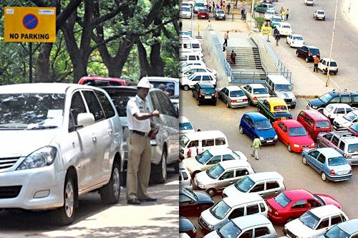
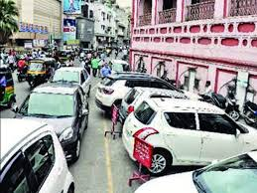
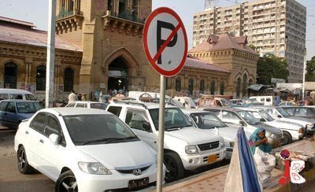
PROBLEMS

Slide 4
SOLUTION
SparCar is the solution provide by us. It is a mobile application which address both searching and scarcity of parking.
It brings both the people who are in need of parking and who provide parking onto the same platform.
It has two clients namely
Customer – is one who is in need of parking slot
Slot Owner – is one who provides the parking slot
Customer
Working Employees
Daily Commuters
Tourists
People who had cars in excess than parking space
People coming to movie theatres , malls , markets , Convention halls and events
Slot Owner
Domestic Houses
Apartments
Public parking places
Private parking places
Empty land Owners

Slide 5
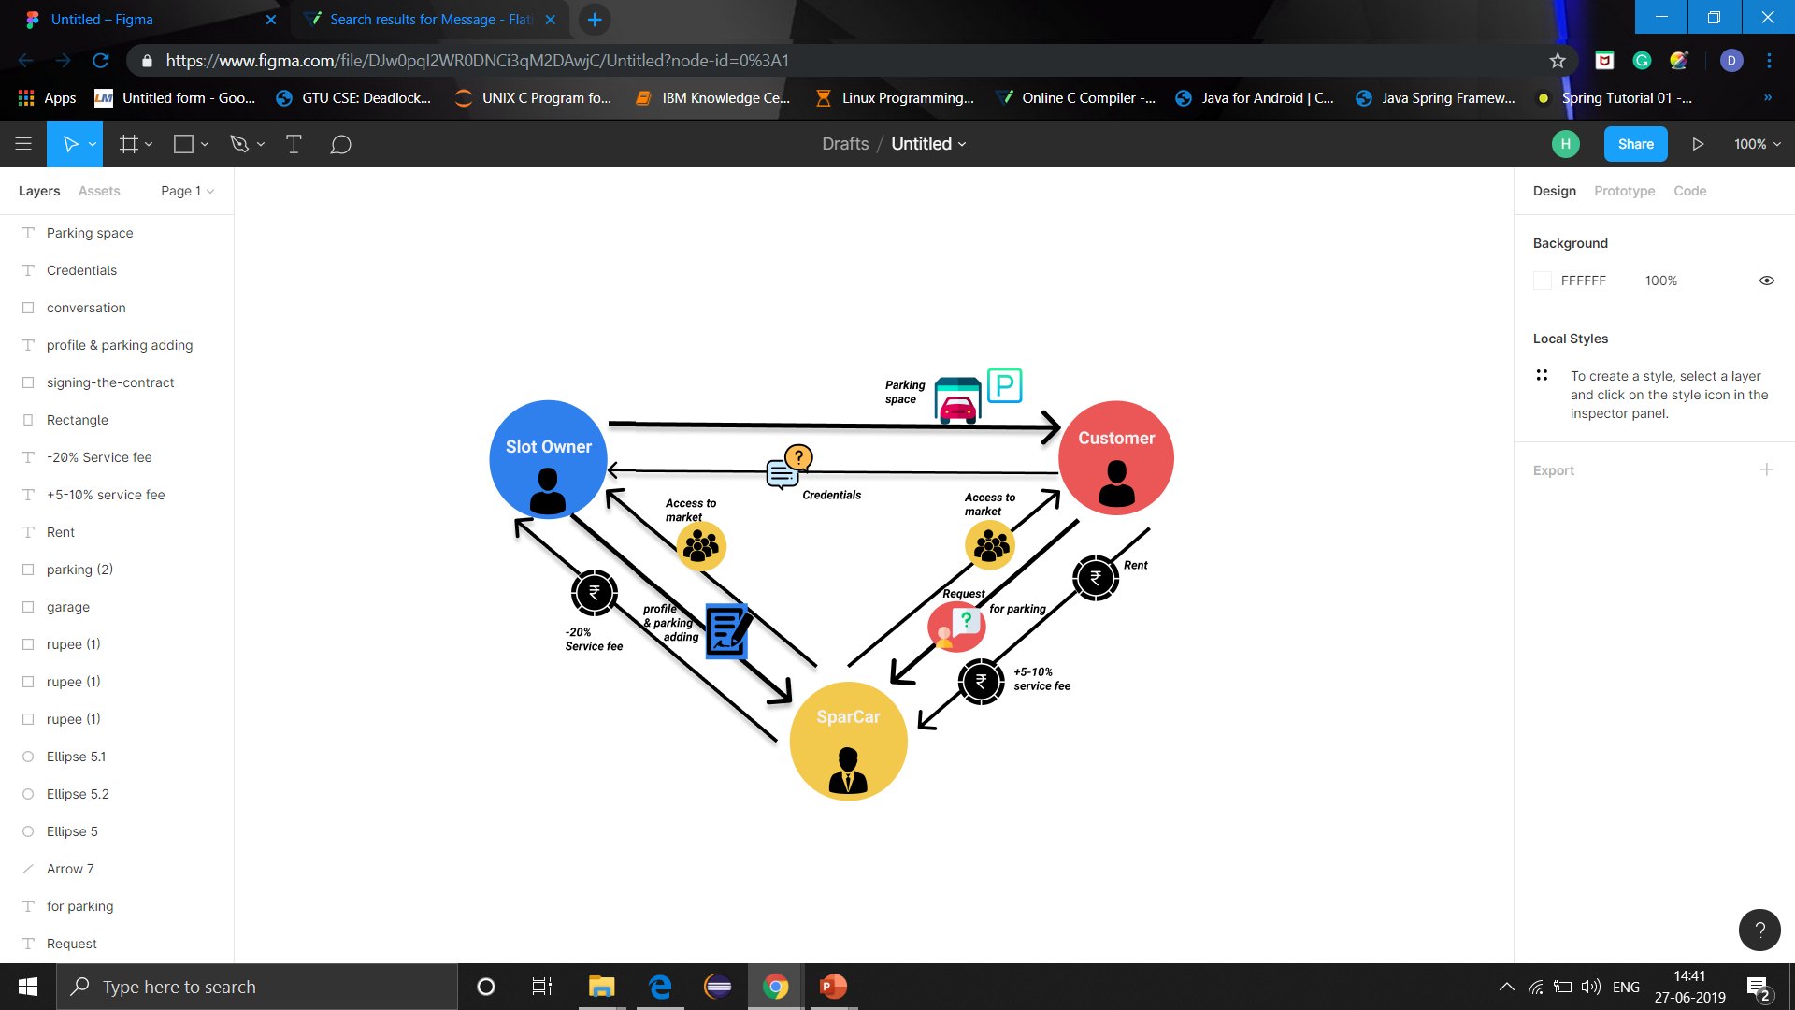
WORKING MODEL

Slide 6
USECASES
Metro Stations
Bus Stations & Railway Stations
Valet Parking
Vegetable Markets & Dmart,
Spencers
Movie Theatres & Malls
Functions Halls and Convention Halls
SparCar

Slide 7
CUSTOMERS & COMPETITORS
TARGET CUSTOMERS
Working Employees who travel in Cars
Daily Commuters of Metro , Bus or Trains
Domestic Houses & Apartments
Private & Public Parking Places Owners & Users
People coming to
Function Halls & Convention Halls
Malls , Movie Theatres & Markets
COMPETITORS
Traditional Private & Public Parking Places
Valet Parking's (in Metropolitan Cities)
Unique differentiation
Approach of buyer and Seller is unique and inclusion domestic houses, apartments is novel
We are not using separate land or constructing new parking areas. Instead we making use of existed parking slots in domestic houses and apartments which is both ECO & ECONOMICAL -FRIENDLY.

Slide 8
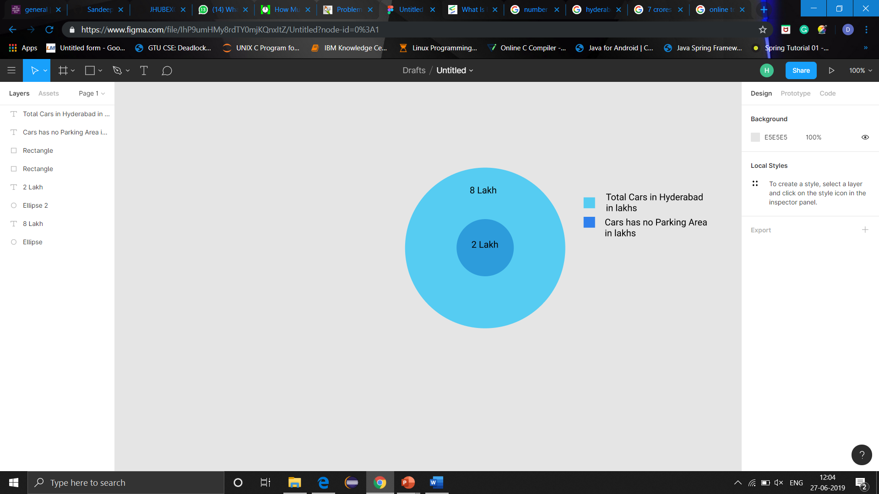
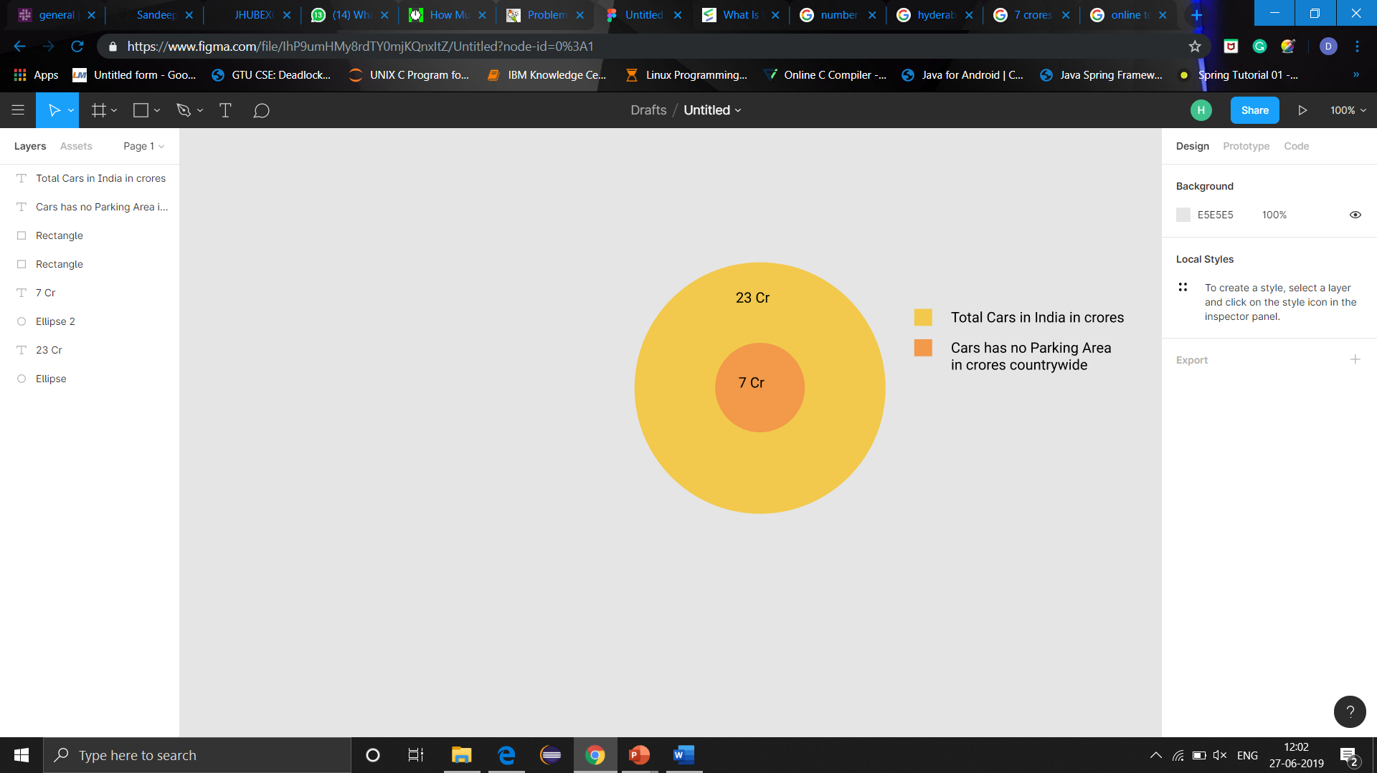
MARKET SIZE & BUSINESS MODEL
BUSINESS MODEL
data collected from :https://community.data.gov.in/registered-motor-vehicles-in-india-as-on-31-03-2015/

Slide 9
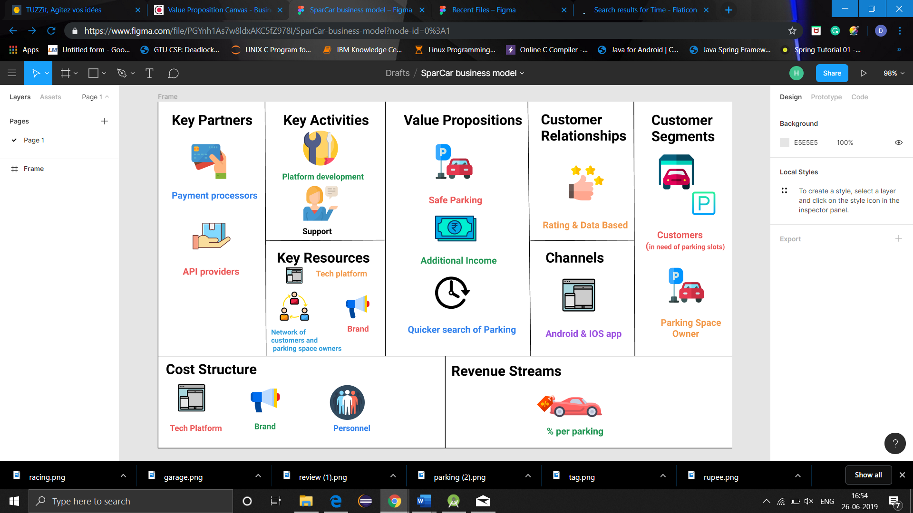
BUSINESS MODEL

Slide 10
BUSINESS PLAN
Making Money:
20% from each Parking Slot customer books and remaining money to slot owner.
For ex: 300 booking a day & Rs.100 each slot . By month ending 300*100*30 = 900,000 of which 20 % is Rs 1,80,000 is the money we make.
Break-Even:
3 months would be break even if initial investment is 5Lakh.
GTM Strategy:
As it is B2C approach, channel through which app is available is Play Store & App Store
Customer Acquisition:
30% percent offer for parking to on-boarding customers
Referendum strategy with 10% offer
Advertising both online &offline on marketing platforms
Brochures, Postures, News Papers
For above example, CAC would be 30% +10% =40% of income i.e Rs.72,000 but there is a acquisition of Life Time Customer .

Slide 11


Slide 12
TEAM
Darahasini Biruduraju, Team Leader [Programmer & API Handler]
Samir Krishna Cholleti, Team member [Programmer & API Handler]
Srikar Rao Ayilneni , Team member [Programmer & Database Manager]
Naveen Doppa ,Team Member [Programmer & Database Manager]

Slide 13
Q&A

